Slide 1





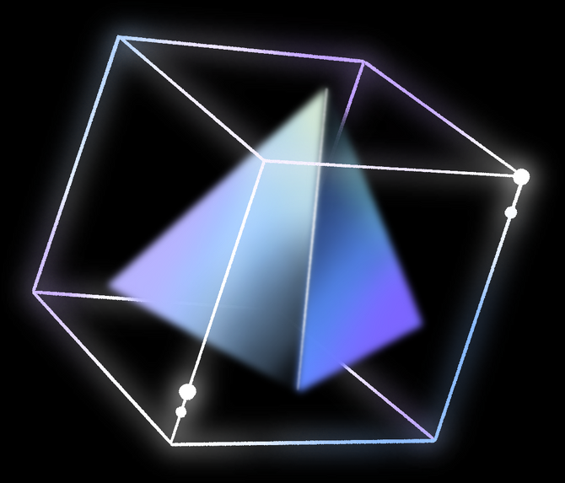
TASK 4
SYSTEM MODELLING AND DESIGN
By Group 8

Slide 2

TABLE OF CONTENTS
Introduction
2.System Modelling
3.System Design
4.Conclusion

Slide 3
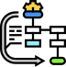
INTRODUCTION
System design and modelling are critical phases in the development of robust efficient and scalable systems. we would delve into the principles methodologies and tools used in the design and modelling.
DESIGN
Modelling
MODELLING

Slide 4
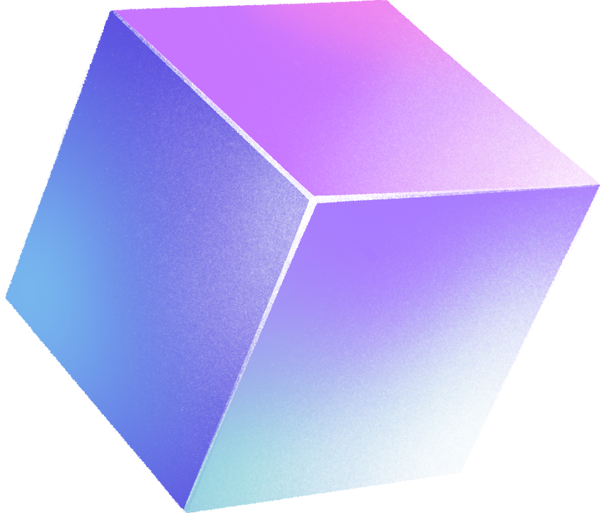
SYSTEM MODELLING
System modeling is a method employed in systems engineering to develop abstract depictions of intricate systems. These representations aid in comprehending, evaluating, and conveying the structure, behavior, and relationships among the components of our system.
CONTEXT
SEQUENCE
DEPLOYMENT
USECASE
CLASS
ACTIVITY

Slide 5
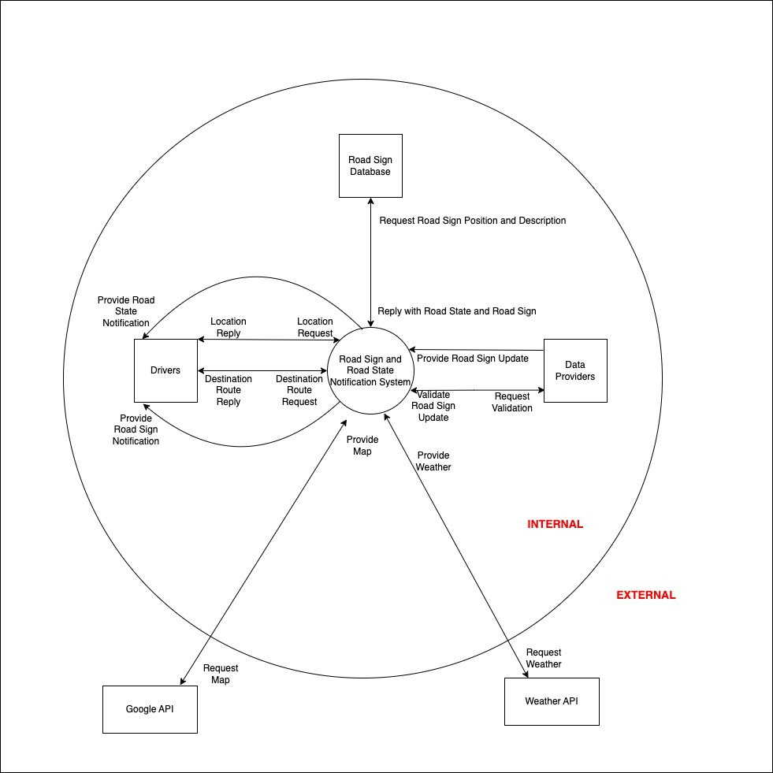
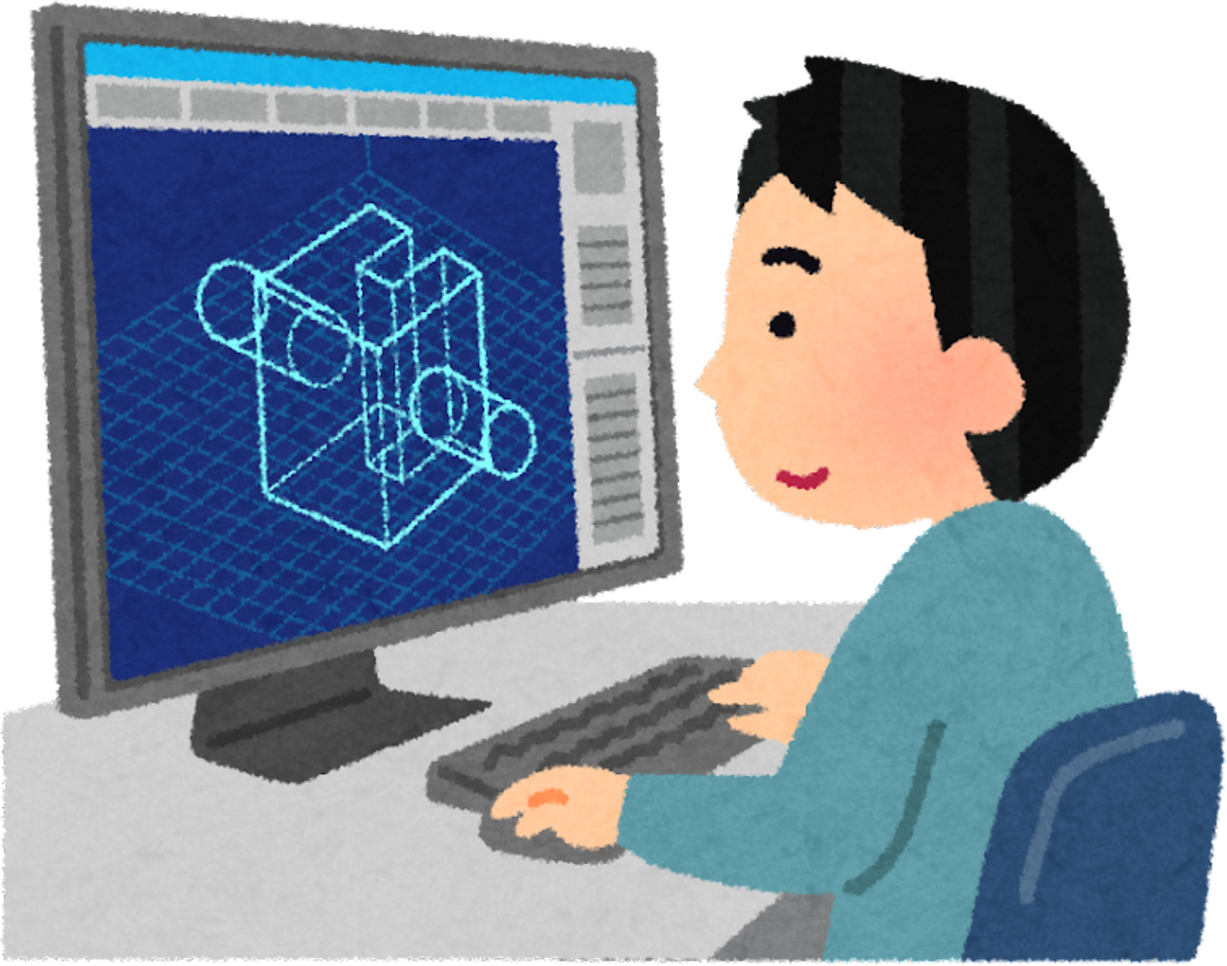
1.CONTEXT DIAGRAM
A context diagram is a high-level view of a system. It’s a basic sketch meant to define an entity based on its scope, boundaries, and relation to external components.

Slide 6
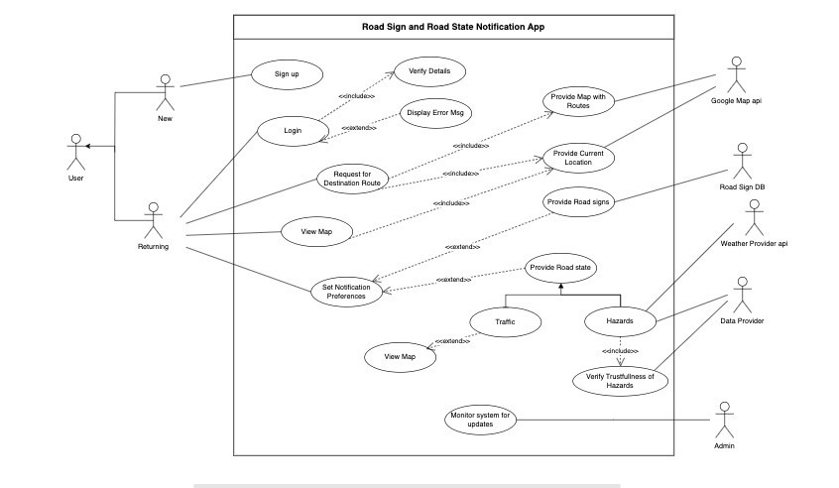

2. USE CASE DIAGRAM
A use case diagram is a visual representation of how users interact with the system to achieve a specific goal. It’s like a blue print showing the functionalities of the system from user’s perspectives.

Slide 7
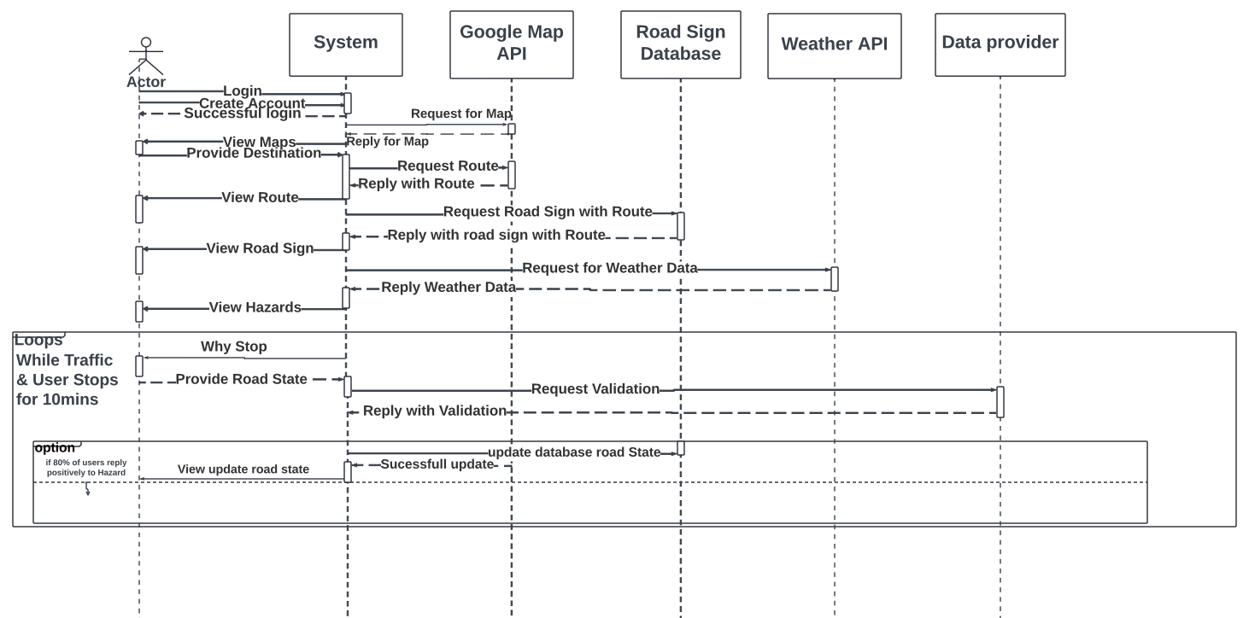

3. SEQUENCE DIAGRAM
A sequence is a UML diagram that provides a visual representation of how objects in systems interact with each other over time.wing the functionalities of the system from user’s perspectives.

Slide 8
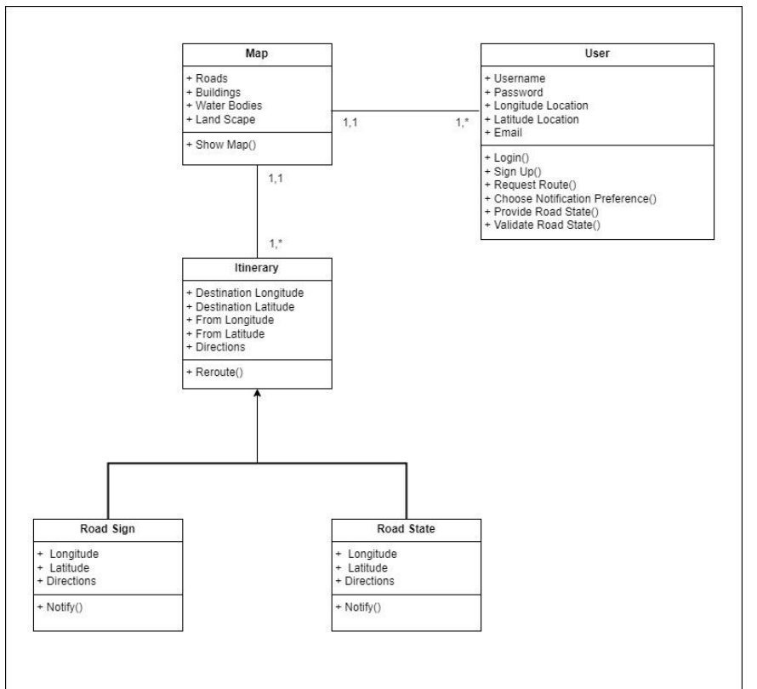

4.CLASS DIAGRAM
A class diagram is a blueprint that visually represents the building blocks of a system. It focuses on the static structure, showing classes and their attributes, operations and the relationship between classes.

Slide 9
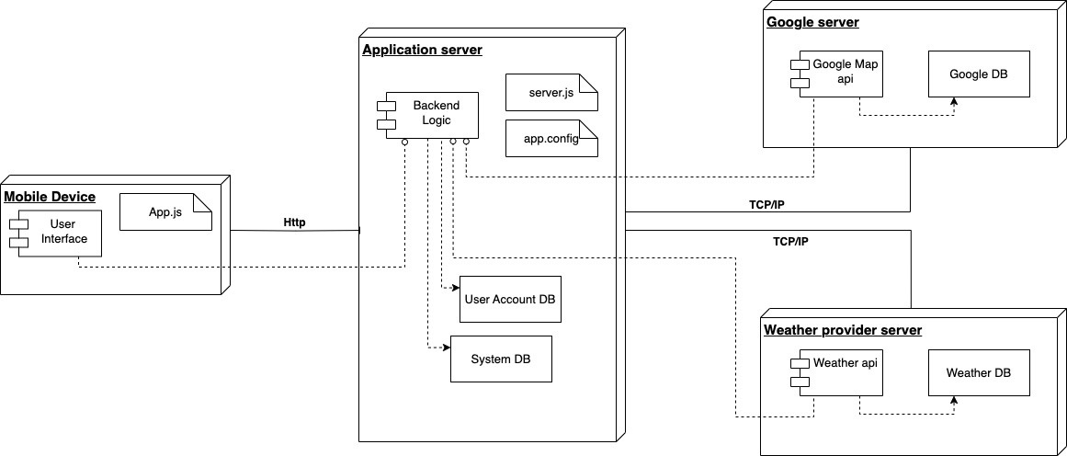
5. DEPLOYMENT DIAGRAM
A deployment diagram is a way to visualise how the software and its components will be deployed physically on a system.

Slide 10
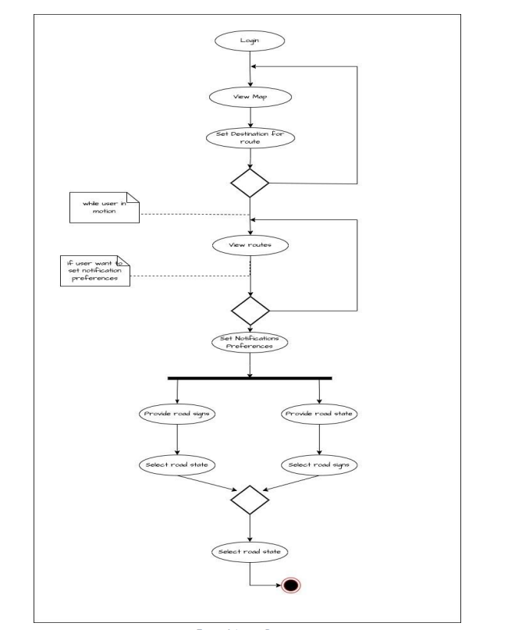

6. ACTIVITY DIAGRAM
An activity diagram is a visual representation of a workflow or process. It shows the sequential steps involves, including decision points and potential alternative paths.

Slide 11
SYSTEM DESIGN
SYSTEM DESIGN IS THE PROCESS OF DEFINING THE ARCHITECTURE, COMPONENTS, INTERFACES, AND DATA FOR A
SYSTEM TO SATISFY SPECIFIED REQUIREMENTS. IT IS A BLUEPRINT FOR BUILDING A SYSTEM THAT OUTLINES HOW
THE SYSTEM WILL FUNCTION, ITS COMPONENTS, AND THE INTERACTION BETWEEN THOSE COMPONENTS

Slide 12

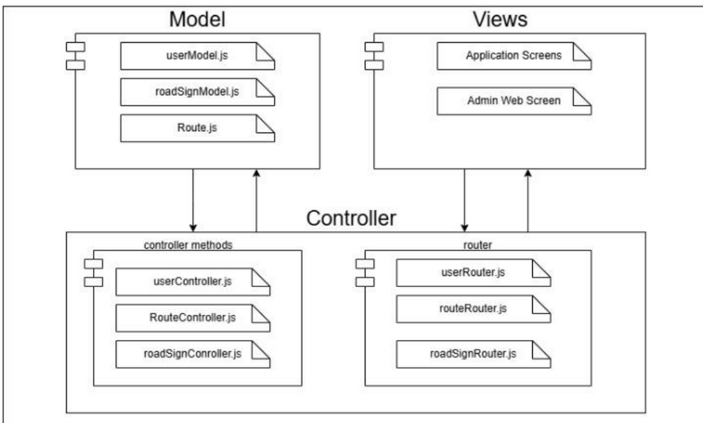
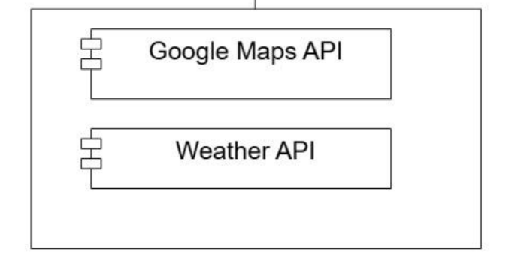
ARCHITECTURE DEFINITION
Our system makes use of a hybrid architecture. This consist of Model View Controller architecture and the MicroService architecture.
MVC Architecture
2. Micro Service Architecture

Slide 13
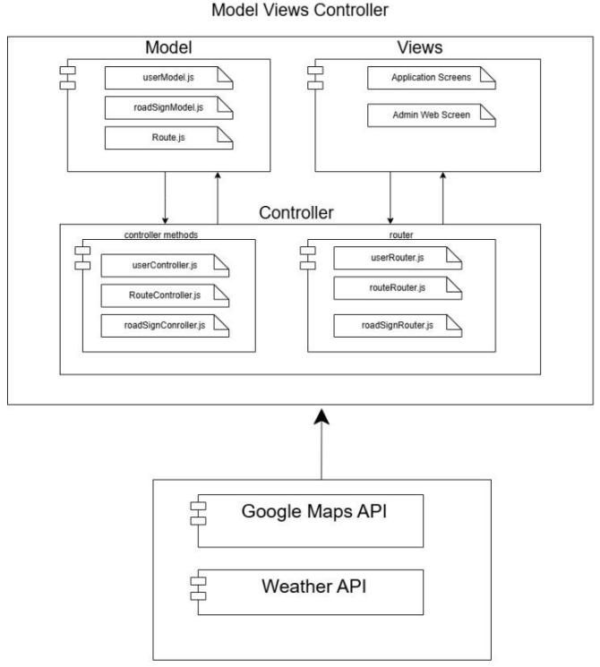

HYBRID ARCHITECTURE
Here we see the interaction of of the different architectures to provides the systems required functionality.
All this then consist of our server which can be accessed by the users of our system.

Slide 14
CONCLUSION
Design and modeling are integral components in software or product development as they provide a comprehensive comprehension of the system under construction. This clarity aids in monitoring our advancement and trajectory during the development phase. Moreover, any new developer joining the team can effortlessly acclimate to the process through the provided documentation.
Up Next...
User Interface Design and Implementation
Thanks you

